Slide 1
Digital Portfolio
STUDENT NAME: ESTHER MERY . M
REGISTER NO AND NMID: asunm1729212406025
DEPARTMENT: BACHELOR OF COMPUTER APPLICATION
COLLEGE:PRINCE SHRI BALAJI ARTS AND SCIENCE COLLEGE/ UNIVERSITY OF MADRAS

Slide 2
PROJECT TITLE
PROFESSIONAL
PORTFOLIO

Slide 3


AGENDA
Problem Statement
Project Overview
End Users
Tools and Technologies
Portfolio design and Layout
Features and Functionality
Results and Screenshots
Conclusion
Github Link
3/21/2024 Annual Review

Slide 4

PROBLEM STATEMENT
Recruiters and clients want quick, interactive, and professional platforms to know about candidates. Many talented individuals lack a personal online identity → Missing opportunities.

Slide 5

PROJECT OVERVIEW
Developed a modern, responsive, and user-friendly portfolio website. Acts as a personal brand hub showcasing skills, projects, and achievements. Built with HTML, CSS, and JavaScript ensuring clean UI + smooth UX. 🎯 Goal: Make a lasting impression on recruiters and clients.

Slide 6

WHO ARE THE END USERS?
👩‍🎓 Students – Showcase projects & skills 👨‍💻 Job Seekers – Impress recruiters 🎨 Freelancers – Attract global clients 🏢 Organizations – Quick evaluation of candidates 💡 Portfolio = Digital Resume + Creative Showcase

Slide 7

TOOLS AND TECHNIQUES
🛠 Frontend: HTML5, CSS3, JavaScript 🎨 Design Tools: Flexbox, CSS Grid, Responsive UI principles 💻 Editor: VS Code 📂 Version Control: Git & GitHub 👉 (Can display icons/logos of these tools for visual impact)

Slide 8
POTFOLIO DESIGN AND LAYOUT
📌 Sections Included: 1️⃣ Header & Navigation 2️⃣ Hero Banner – “Hello, I’m [Your Name]” 3️⃣ About Me 4️⃣ Skills Showcase 5️⃣ Projects Gallery 6️⃣ Contact Form 7️⃣ Footer 🎨 Design Theme: Minimal ✚ Elegant ✚ Professional ✨ Balanced use of colors, typography, and white space.
8

Slide 9
FEATURES AND FUNCTIONALITY
✅ Responsive for all devices ✅ Smooth navigation & scrolling ✅ Highlighted skills in creative tags ✅ Interactive project cards ✅ Contact form with live alert ✅ Simple yet professional branding 💡 Add hover animations, reveal effects, & transitions for creativity.

Slide 10
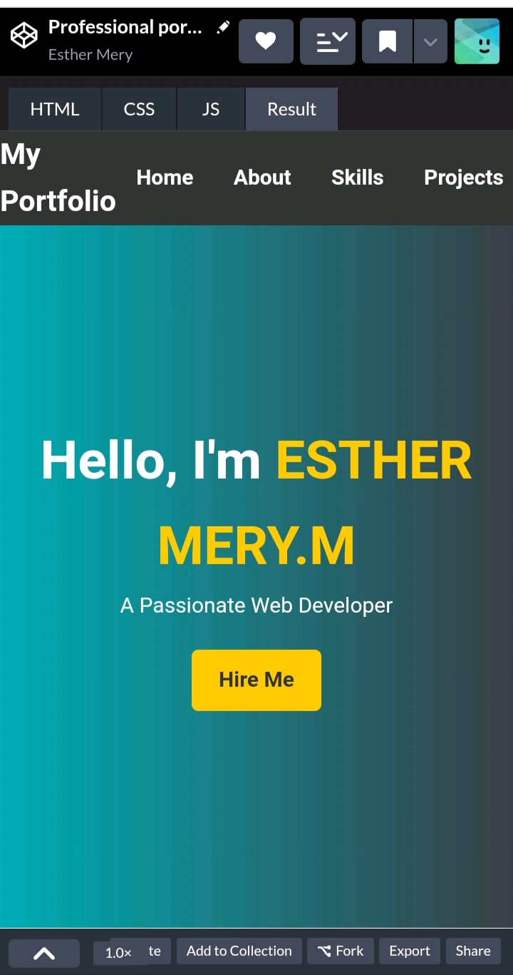

RESULTS AND SCREENSHOTS
3/21/2024 Annual Review
10

Slide 11
CONCLUSION
🚀 The project improved my knowledge in: ✅ Web development (HTML, CSS, JS) ✅ UI/UX design principles ✅ Responsive layout building
11

